Slide 1
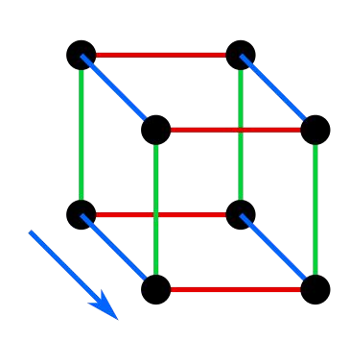
Dimensionality Reduction

Slide 2
Introduction - Curse of Dimensionality
Some problem sets may have
Large number of feature set
Making the model extremely slow
Even making it difficult to find a solution
This is referred to as ‘Curse of Dimensionality’

Slide 3
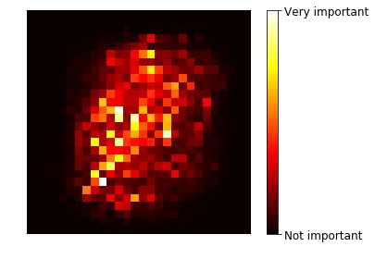

Introduction - Curse of Dimensionality
Example
MNIST Dataset
Each pixel was a feature
(28*28) number of features for each image
Border feature had no importance and could be ignored
Border data (features) can be ignored for all datasets

Slide 4
Introduction - Curse of Dimensionality
Example
MNIST Dataset
Also, neighbouring pixels are highly correlated
Neighbouring pixels can be merged into one without losing much of information
Hence, further reducing the dimensions or features

Slide 5
Introduction - Curse of Dimensionality
Some benefits of dimension reduction
Faster and more efficient model
Better visualization to gain important insights by detecting patterns
Drawbacks:
Lossy - we lose some information - we should try with the original dataset before going for dimension reduction

Slide 6
Introduction - Curse of Dimensionality
Some important facts
Q. Probability that a random point chosen in a unit metre square is 0.001 m from the border?
Ans. ?

Slide 7
Introduction - Curse of Dimensionality
Some important facts
Q. Probability that a random point chosen in a unit metre square is 0.001 m from the border?
Ans. 0.004 = 1 - (0.998)**2

Slide 8
Introduction - Curse of Dimensionality
Some important facts
Q. Probability that a random point chosen in a unit metre square is 0.001 m from the border?
Ans. 0.004, meaning chances are very low that the point will extreme along any dimension
Q. Probability that a random point chosen on a 10,000 dimensional unit metre hypercube is 1 mm from the border?
Ans. >99.999999 %

Slide 9
Introduction - Curse of Dimensionality
Some more important facts
If we pick 2 points randomly on a unit square
The distance between these 2 points shall be roughly 0.52
See https://youtu.be/i4VqXRRXi68
If we pick 2 points randomly in a 1,000,000 dimension hypercube
The distance between these 2 points shall be roughly sqrt(1000000/6)

Slide 10
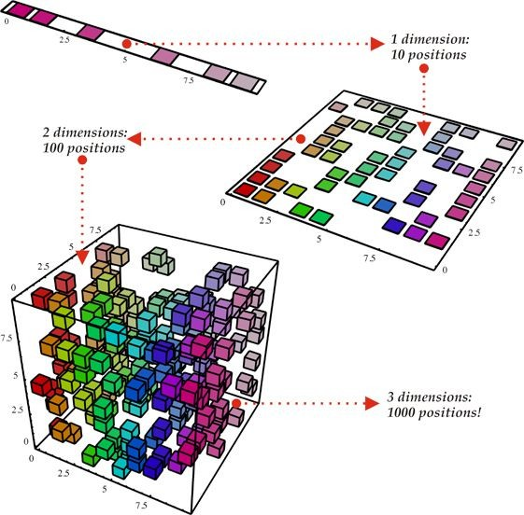
Introduction - Curse of Dimensionality
Some important observations about large dimension datasets
Higher dimensional datasets are at risk of being very sparse
Most training sets are likely to be far away from each other
Instances much more scattered in higher dimensions, hence sparse

Slide 11
Introduction - Curse of Dimensionality
New dataset (test) dataset will also likely be far away from any training instance
making predictions much less reliable
Hence,
more dimensional the training set is,
the greater the risk of overfitting.

Slide 12
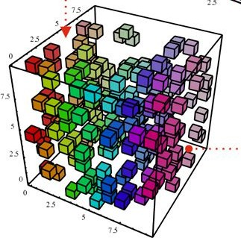
Introduction - Curse of Dimensionality
How to reduce the curse of dimensionality?
Increase the size of training set (number of datasets) to reach a sufficient density of training instances
However, number of instances required to reach a given density grows exponentially with the number of dimensions (features)
Adding more instances will increase the density

Slide 13
Introduction - Curse of Dimensionality
How to reduce the curse of dimensionality?
Example:
For a dataset with 100 features
Will need more training datasets than atoms in observable universe
To have the instances on an average 0.1 distance from each other (assuming they are spread out equally)
Hence, we reduce the dimensions

Slide 14
Dimensionality Reduction
Main approaches for dimensionality reduction
Projection
Manifold Learning

Slide 15
Dimensionality Reduction
Dimensionality Reduction Methods
Projection
Manifold Learning

Slide 16
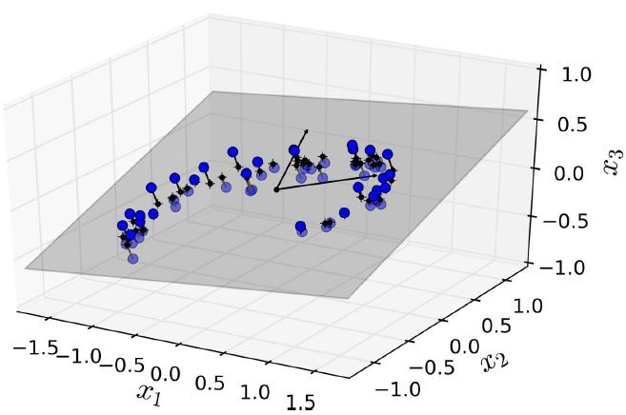
Dimensionality Reduction - Projection
Most real-world problems do not have training instances spread out across all dimensions
Many features are almost constant -
While others are correlated
Q. How many features are there in the above graph?

Slide 17
Dimensionality Reduction - Projection
Most real-world problems do not have training instances spread out across all dimensions
Many features are almost constant -
While others are correlated
Q. How many features are there in the above graph? 3

Slide 18
Dimensionality Reduction - Projection
Most real-world problems do not have training instances spread out across all dimensions
Many features are almost constant -
While others are correlated
Q. Which of the feature is almost constant for almost all instances? x1, x2 or x3?

Slide 19
Dimensionality Reduction - Projection
Most real-world problems do not have training instances spread out across all dimensions
Many features are almost constant -
While others are correlated
Q. Which of the feature is almost constant for almost all instances? Ans: x3

Slide 20
Dimensionality Reduction - Projection
Most of the training instances actually lie within (or close to) a much
lower-dimensional subspace.
Refer the diagram below
A
3-dimensional space (x1, x2 and x3)
A lower
2-dimensional subspace (grey plane)

Slide 21
Dimensionality Reduction - Projection
Not all instances are ON the 2-dimensional subspace
If we project all the instances perpendicularly on the subspace
We get the new 2d dataset with features z1 and z2
A
3-dimensional space (x1, x2 and x3)
A lower
2-dimensional subspace (grey plane)
projections

Slide 22
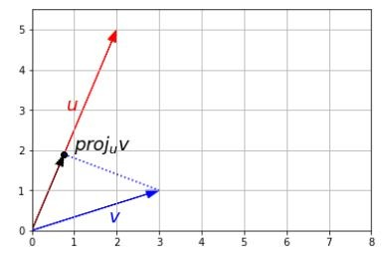
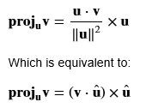
Remember projection from Linear Algebra?
As we have seen in linear algebra session,
A vector v can be projected onto
another vector u
By doing a dot product of v and u.

Slide 23
Remember projection from Linear Algebra?
Q. For the graph below, which of these is true?
Vector v is orthogonal to u
Vector v is projected into vector u
Vector u is projected into vector v

Slide 24

Remember projection from Linear Algebra?
For the graph below, which of these is true?
Vector v is orthogonal to u
✅ Vector v is projected into vector u
Vector u is projected into vector v

Slide 25
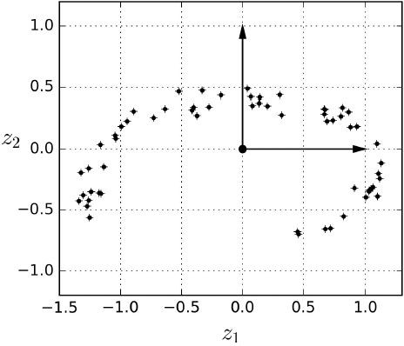
Dimensionality Reduction - Projection
Like we project a vector onto another, we can project a vector onto a plane by a dot product.
If we project all the instances perpendicularly on the subspace
We get the new 2d dataset with features z1 and z2

Slide 26

Dimensionality Reduction - Projection
The above example is demonstrated on notebook
Download the 3d dataset
Reduce it to 2 dimensions using PCA - a dimensionality reduction technique based on projection
Define a utility to plot the projection arrows
Plot the 3d dataset, the plane and the projection arrows
Draw the 2d equivalent
Switch to Notebook

Slide 27
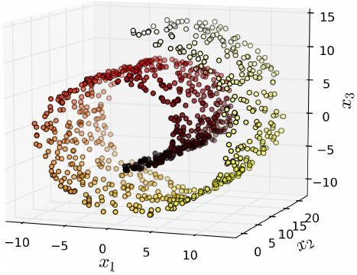

Dimensionality Reduction - Projection
Is projection always good?
Not really! Example: Swiss roll toy dataset

Slide 28
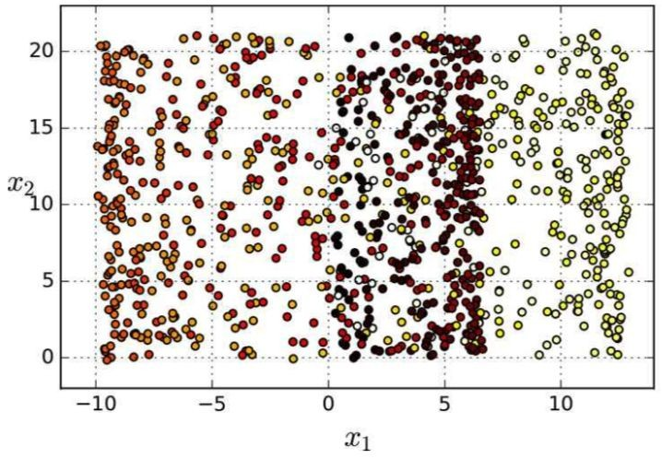
Dimensionality Reduction - Projection
Is projection always good?
Not really! Example: Swiss roll toy dataset
What if we project the training dataset onto x1 and x2.
The projection squashes the the different layers and hence classification is difficult

Slide 29
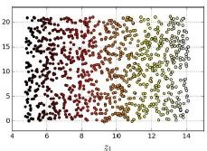
Dimensionality Reduction - Projection
What if we instead open the swiss roll?
Opening the swiss roll does not squash the different layers
The layers are classifiable.

Slide 30
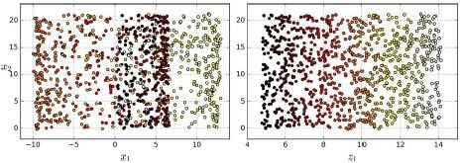
Dimensionality Reduction - Projection
Projection does not seem to work in the case of swiss roll or similar datasets

Slide 31
Dimensionality Reduction - Projection
The above limitation of Projection can be demoed in the following steps:
Visualizing the swiss roll on a 3d plot
Projecting the swiss roll on the x1 and x2
Visualizing the squashed projection
Visualizing the rolled out plot
Switch to Notebook

Slide 32
Dimensionality Reduction
Dimensionality Reduction Methods
Projection
Manifold Learning

Slide 33
Dimensionality Reduction - Manifold Learning
Swiss roll is an example 2d manifold
2d manifold is a 2d shape that can be bent and twisted in a higher-dimensional space
A d-dimensional space is a part of n-dimensional space (d<n)
Q. For swiss roll, d =? , n =?

Slide 34
Dimensionality Reduction - Manifold Learning
Swiss roll is an example 2d manifold
2d manifold is a 2d shape that can be bent and twisted in a higher-dimensional space
A d-dimensional space is a part of n-dimensional space (d<n)
Q. For swiss roll, d =2 , n =3

Slide 35
Dimensionality Reduction - Manifold Learning
Many dimensionality reduction algorithms work by
modeling the manifold on which the training instances lie
This is called manifold learning
So, for the swiss roll
We can model the 2d plane
Which is rolled in a swiss roll fashion
Hence occupying a 3d space (like rolling of a paper)

Slide 36
Dimensionality Reduction - Manifold Learning
Manifold Learning
Relies on manifold assumption, i.e.,
Most real-world high-dimensional datasets lie close to a much lower-dimensional manifold
This is observed often empirically

Slide 37
Dimensionality Reduction - Manifold Learning
Manifold assumption is observed empirically in case of
MNIST dataset where images of the digits have similarities:
Made of connected lines
Borders are white
More or less centered
A randomly generated image would have much larger degree of freedom as compared to the images of digits
Hence, the constraints in the MNIST images tend to squeeze the dataset into a lower-dimensional manifold.

Slide 38
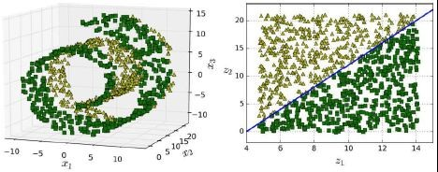
Dimensionality Reduction - Manifold Learning
Manifold learning is accompanied by another assumption
Going to a lower-dimensional space shall make the task-at-hand simpler (holds true in below case)
Simple classification

Slide 39
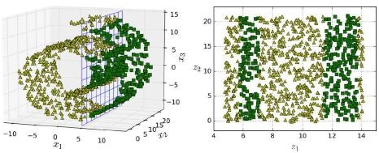
Dimensionality Reduction - Manifold Learning
Manifold assumption accompanied by another assumption
Going to a lower-dimensional space shall make the task-at-hand
simpler (Not always the case)
Fairly complex classification
Simple classification (x1=5)

Slide 40
Dimensionality Reduction - Manifold Learning
The previous 2 cases can be demonstrated in these steps:
Using the 3d swiss roll dataset
Plotting the case where the classification gets easier with manifold
Plotting the case where the classification gets difficult with manifold
Plotting the decision boundary in each case
Switch to Notebook

Slide 41
Dimensionality Reduction
Summary - Dimensionality Reduction
2 approaches: Projection and Manifold Learning
Depends on the dataset, which should be used
Leads to better visualization
Faster training
May not always lead to a better or simpler solution
Valid both for projection or manifold learning
Depends on the dataset
Lossy
Should always try with the original dataset before going for dimensionality reduction

Slide 42
Dimensionality Reduction
Dimensionality Reduction Methods
Approach: Projection Technique: PCA
Manifold Learning

Slide 43
Principal Component Analysis (PCA)
The most popular dimensionality reduction algorithm
Identify the hyperplane that lies closest to the data
Projects the data onto the hyperplane

Slide 44
Dimensionality Reduction - Projection
How?

Slide 45
PCA- Preserving the variance
How do we select the best hyperplane to project the datasets into?
Select the axis that preserves the maximum amount of variance
Lose less information than other projections

Slide 46
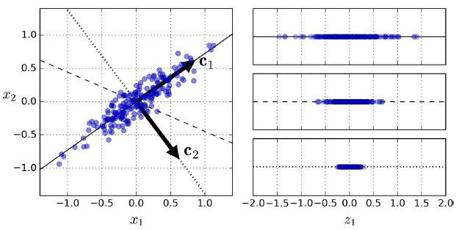
PCA- Preserving the variance
c1
c3 c2
Q. Which of these is the best axes to select (preserves maximum variance)?
c1 or c2 or c3?

Slide 47
PCA- Preserving the variance
c1
c3 c2
Q. Which of these is the best axes to select? Ans: c1.
Preserves maximum variance as compared to other axes.

Slide 48
PCA- Preserving the variance
c1
c3 c2
Another way to say the axis that minimizes the mean squared distance between the original dataset and its projection onto that axis.

Slide 49
Dimensionality Reduction - Manifold Learning
The previous case can be demonstrated in these steps:
Generate a random 2d dataset
Stretch it along a particular direction
Project it along certain 3 axis
Plot the stretched random numbers, the projections along the axes
Switch to Notebook

Slide 50
PCA- Principal Components
How do we select the best hyperplane to project the datasets into?
Ans: PCA
identifies the axis that accounts for the largest amount of variance in the training set - 1st principal component
Provides a second axis orthogonal to the first one that accounts for second largest
And so on.. Third axis, fourth axis..

Slide 51
PCA- Principal Components
The unit vector that defines that ‘i’th axis is called the ‘i’th principal component (PC)
1st PC = c1
2nd PC = c2
3rd PC = c3
C1 is orthogonal to c2, c3 would be orthogonal to the plane formed by c1 and c2,
And hence orthogonal to both c1 and c2.
Image in 3d space for a minute!

Slide 52
PCA- Principal Components
Next Ques: How do we find the principal components?
Standard factorization technique called Singular Value Decomposition (SVD) - based on eigenvalue calculation!
It divides the training dataset into the dot product of 3 matrices
U
∑
transpose(V)
Transpose(V) contains the principal components (PC) - unit vectors

Slide 53
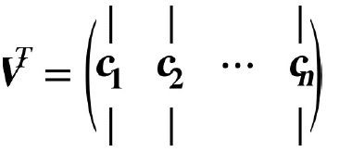
PCA- Principal Components
Transpose(V) contains the principal components (PC) - unit vectors
1st PC = c1
2nd PC = c2
3rd PC = c3
...

Slide 54
PCA- Principal Components - SVD
SVD can implemented in scikit-learn using the code below
SVD assumes that the data is centered around the origin
# Data needs to centralized before performing SVD
>>> X_centered = X - X.mean(axis=0) # Performing SVD
>>> U,s,V = np.linalg.svd(X_centered)
# Printing the principal components
>>> c1, c2 = V.T[:,0], V.T[:,1]
print(c1,c2)
Q. How many principal components are we printing in the above code?

Slide 55
PCA- Principal Components - SVD
SVD can implemented in scikit-learn using the code below
SVD assumes that the data is centered around the origin
# Data needs to centralized before performing SVD
>>> X_centered = X - X.mean(axis=0) # Performing SVD
>>> U,s,V = np.linalg.svd(X_centered)
# Printing the principal components
>>> c1, c2 = V.T[:,0], V.T[:,1]
print(c1,c2)
Q. How many principal components are we printing in the above code?
Ans: 2

Slide 56
PCA- Projecting down to d dimensions
Once, the PCs have been found, original dataset has to be projected on the PCs
As we have seen in linear algebra session,
A vector v can be projected onto
another vector u
By doing a dot product of v and u.

Slide 57
PCA- Projecting down to d dimensions
Similarly, the
original training dataset X can be projected onto
the first ‘d’ principal components Wd
Composed of first ‘d’ columns of transpose(V) obtained in SVD
Reducing the dataset dimensions to ‘d’
^{X}d-proj ^{= X.W}d
Wd = first d columns of transpose(V) containing the first d principal components

Slide 58
PCA- Projecting down to d dimensions
Similarly, the
original training dataset X can be projected onto
the first ‘d’ principal components Wd
Composed of first ‘d’ columns of transpose(V) obtained in SVD
Reducing the dataset dimensions to ‘d’
First ‘d’ columns of the transpose(V)
Wd =

Slide 59
PCA- SVD and PCA
So, PCA involves two steps
SVD and
Projection of the training dataset onto the orthogonal principal components
Scikit-Learn provides functions for both
SVD, projection and
Combined PCA
We will be comparing the codes for these

Slide 60
PCA- SVD and PCA
PCA using SVD in Sci-kit Learn | PCA using Sci-kit Learn PCA function
# Centering the data and doing SVD X_centered = X - X.mean(axis=0) U,s,V = np.linalg.svd(X_centered) # Extracting the components and projecting the # original dataset W2 = V.T[:, :2] X2D = X_centered.dot(W2) | from sklearn.decomposition import PCA # Directly doing PCA and transforming the original dataset # Takes care of centering pca = PCA(n_components = 2) X2D = pca.fit_transform(X)
Switch to Notebook

Slide 61
PCA- Explained Variance Ratio
Variances explained by each of the components is important
We would like to cover as much variance as in the original dataset
available via the explained_variance_ratio_ variable
>>> print(pca.explained_variance_ratio_) [ 0.95369864 0.04630136]
1st component covers 95.3 % of the variance
2nd component covers 4.6 % of the variance

Slide 62
PCA- Number of PCs
How to select the number of principal components
The principal components should explain 95% of the variance in original dataset
For visualization, it has to be reduced to 2 or 3
Calculating the variance explained in Scikit-Learn
>>> pca = PCA()
>>> pca.fit(X)
>>> cumsum = np.cumsum(pca.explained_variance_ratio_)
# Calculating the number of dimensions which explain 95% of variance
>>> d = np.argmax(cumsum >= 0.95) + 1 2

Slide 63
PCA- Number of PCs
# Calculating the PCs directly specifying the variance to be explained
>>> pca = PCA(n_components=0.95)
>>> X_reduced = pca.fit_transform(X)

Slide 64
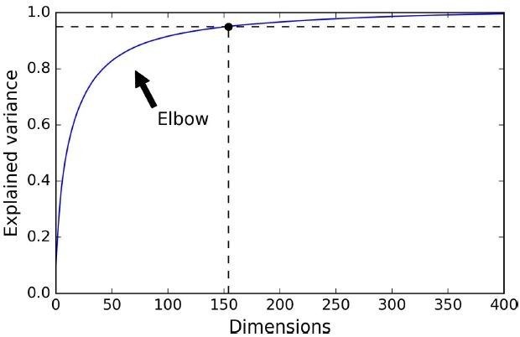
PCA- Number of PCs
Another option is to plot the explained variance
As a function of the number of dimensions
Elbow curve: explained variance stops growing fast after certain number of dimensions

Slide 65
Dimensionality Reduction - Projection
For the above 2d dataset, we shall demonstrate
Calculating the estimated variance ratio
Calculating the number of principal components
Switch to Notebook

Slide 66
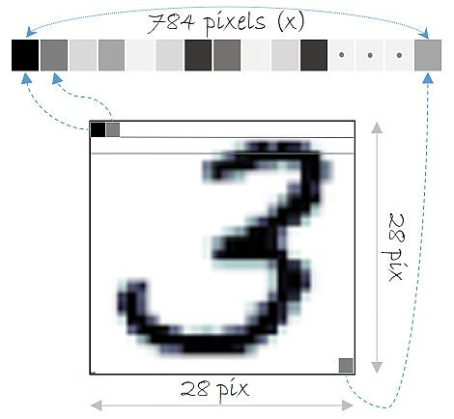
PCA- Compression of dataset
Another aspect of dimensionality reduction,
the training set takes up much less space.
For example, applying PCA to MNIST dataset
ORIGINAL: Each image
28 X 28 pixels
784 features
Each pixel is either on or off 0 or 1

Slide 67
PCA- Compression of dataset
After applying PCA to the MNIST data
Number of dimensions reduces to 154 features from 784 features
Keeping 95% of its variance
Hence, the training set is 20% of its original size
>>> pca = PCA()
>>> pca.fit(X)
>>> d = np.argmax(np.cumsum(pca.explained_variance_ratio_) >= 0.95) + 1 154
Number of features required to explain 95% variance

Slide 68
PCA- Compression of dataset - Demo
Loading the MNIST Dataset
#MNIST compression:
>>> from sklearn.model_selection import train_test_split
>>> from sklearn.datasets import fetch_mldata
>>> mnist = fetch_mldata('MNIST original')
>>> X, y = mnist["data"], mnist["target"]
>>> X_train, X_test, y_train, y_test = train_test_split(X, y)
>>> X = X_train

Slide 69
PCA- Compression of dataset
Applying PCA to the MNIST dataset
# Applying PCA to the MNIST Dataset
>>> pca = PCA()
>>> pca.fit(X)
>>> d = np.argmax(np.cumsum(pca.explained_variance_ratio_) >= 0.95) + 1 154
# Projecting onto the principal components
>>> pca = PCA(n_components=0.95)
>>> X_reduced = pca.fit_transform(X)
>>> pca.n_components_ 154
# Checking for the variance explained
# did we hit the 95% minimum?
>>> np.sum(pca.explained_variance_ratio_) 0.9503623084769206
Switch to Notebook

Slide 70

PCA- Decompression
The compressed dataset can be decompressed to the original size
For MNIST dataset, the reduced dataset (154 features)
Back to 784 features
Using inverse transformation of the PCA projection
# use inverse_transform to decompress back to 784 dimensions
>>> X_mnist = X_train
>>> pca = PCA(n_components = 154)
>>> X_mnist_reduced = pca.fit_transform(X_mnist)
>>> X_mnist_recovered = pca.inverse_transform(X_mnist_reduced)

Slide 71
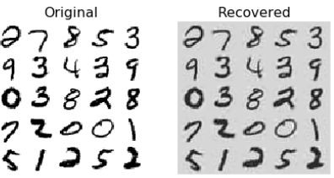
PCA- Decompression
Plotting the recovered digits
Recovered digits has lost some information
Dimensionality reduction captured only 95% of variance
It is called reconstruction error
Original
Recovered
Switch to Notebook

Slide 72
PCA- Incremental PCA
Problem with PCA (Batch-PCA)
Requires the entire training dataset in-the-memory to run SVD
Incremental PCA (IPCA)
Splits the training set into mini-batches
Feeds one mini-batch at a time to the IPCA algorithm
Useful for large datasets and online learning

Slide 73
PCA- Incremental PCA
Incremental PCA using Scikit Learn’s IncrementalPCA class
And associated partial_fit() function instead of fit() and fit_transform()
# split MNIST into 100 mini-batches using Numpy array_split() # reduce MNIST down to 154 dimensions as before.
# note use of partial_fit() for each batch.
>>> from sklearn.decomposition import IncrementalPCA
>>> n_batches = 100
>>> inc_pca = IncrementalPCA(n_components=154)
>>> for X_batch in np.array_split(X_mnist, n_batches): print(".", end="") inc_pca.partial_fit(X_batch)
>>> X_mnist_reduced_inc = inc_pca.transform(X_mnist)

Slide 74
PCA- Incremental PCA
Another way is to use Numpy memap class
Uses binary array on the disk as if it was in-memory
# alternative: Numpy memmap class (use binary array on disk as if it was in memory)
>>> filename = "my_mnist.data"
>>> X_mm = np.memmap(
filename, dtype='float32', mode='write', shape=X_mnist.shape)
>>> X_mm[:] = X_mnist
>>> del X_mm
>>> X_mm = np.memmap(filename, dtype='float32', mode='readonly', shape=X_mnist.shape)
>>> batch_size = len(X_mnist) // n_batches
>>> inc_pca = IncrementalPCA(n_components=154, batch_size=batch_size)
>>> inc_pca.fit(X_mm)
Switch to Notebook

Slide 75
PCA- Randomized PCA
Using a stochastic algorithm
To approximate the first d principal components
O(m × d^2) + O(d^3), instead of O(m × n^2) + O(n^3)
Dramatically faster than (Batch) PCA and Incremental PCA
When d << n
>>> rnd_pca = PCA(n_components=154, svd_solver="randomized")
>>> t1 = time.time()
>>> X_reduced = rnd_pca.fit_transform(X_mnist)
>>> t2 = time.time()
>>> print(t2-t1, "seconds") 4.414088487625122 seconds
Switch to Notebook

Slide 76
Kernel PCA
Using Kernel PCA
Kernel trick can also be applied to PCA
Makes nonlinear projections possible for dimensionality reduction
This is called Kernel PCA (kPCA)
Important point about Kernel PCA we should remember is:
Good at preserving clusters
Useful when unrolling datasets that lies close to a twisted manifold

Slide 77
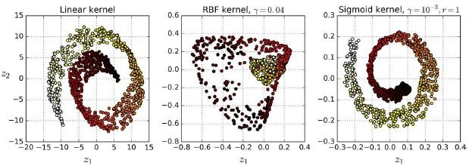
Kernel PCA
Kernel PCA in Scikit-Learn using KernelPCA class
Linear Kernel
RBF Kernel
Sigmoid Kernel

Slide 78
Kernel PCA
Kernel PCA in Scikit-Learn using KernelPCA class
>>> from sklearn.decomposition import KernelPCA
>>> rbf_pca = KernelPCA(n_components = 2, kernel="rbf", gamma=0.04)
>>> X_reduced = rbf_pca.fit_transform(X)
Switch to Notebook

Slide 79
Kernel PCA - Selecting hyperparameters
Selecting hyper parameters
Kernel PCA is an unsupervised learning algorithm
No obvious performance measure to help select the best kernel and hyperparameters
Instead, we can follow these steps:
Create a pipeline with KernelPCA and Classification model
Do a grid search using GridSearchCV to find the best kernel and gamma value for kPCA

Slide 80
Kernel PCA - Selecting hyperparameters
Selecting hyper parameters
Create a pipeline with KernelPCA and Classification model
Doing a grid search using GridSearchCV to find the best kernel and gamma value for kPCA
>>> clf = Pipeline([
("kpca", KernelPCA(n_components=2)), ("log_reg", LogisticRegression())])
>>> param_grid = [{
"kpca gamma": np.linspace(0.03, 0.05, 10), "kpca kernel": ["rbf", "sigmoid"]}]
>>> grid_search = GridSearchCV(clf, param_grid, cv=3)
Switch to Notebook

Slide 81
Kernel PCA - Hyperparameter selection
Reconstruction in Kernel PCA
Another Approach
Entirely unsupervised,
is to select the kernel and hyperparameters
that yield the lowest reconstruction error.
However
Reconstruction is not as easy as with linear PCA

Slide 82
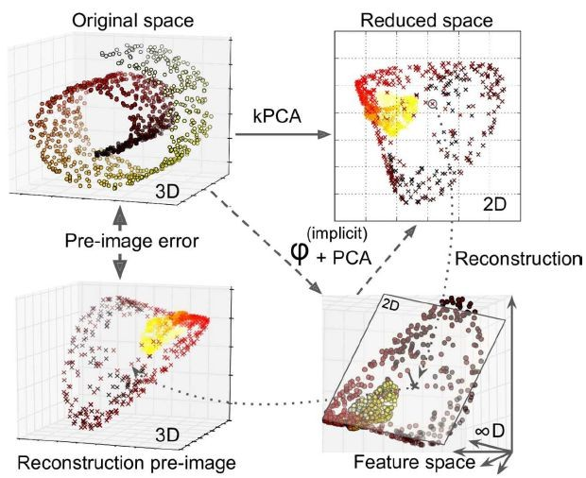
Kernel PCA - Reconstruction
Reconstruction in Kernel PCA

Slide 83
Kernel PCA - Reconstruction
Reconstruction in Kernel PCA
2 steps followed in Kernel PCA
Mapping to a higher infinite-dimensional feature space
Then projecting the transformed training set into 2d using linear PCA
Inverse of linear PCA step would lie in the feature space, not in the original space
Since infinite-dimensional, we cannot compute the reconstruction point
Therefore, cannot compute the true reconstruction error

Slide 84
Kernel PCA - Reconstruction
Reconstruction in Kernel PCA
For reconstruction, we instead use a pre-image
By finding a point in the original space that would map close to the reconstructed point
Can find the squared distance with the original space
Then select the kernel and hyperparameters that minimize the reconstruction pre-image error

Slide 85
Kernel PCA - Reconstruction

Slide 86
Kernel PCA - Reconstruction Error
Calculating reconstruction error when using kernel PCA
Inverse_transform in scikit-learn creates the pre-image
Which can be used to calculate the mean squared error
## Performing Kernel PCA and enabling inverse transform ## to enable pre-image computation
>>> rbf_pca = KernelPCA( n_components = 2, kernel="rbf", gamma=0.0433,
fit_inverse_transform=True) # perform reconstruction
...contd

Slide 87
Kernel PCA - Reconstruction Error
Calculating reconstruction error when using kernel PCA
Inverse_transform in scikit-learn creates the pre-image
Which can be used to calculate the mean squared error
## Calculating the reduced space using kernel PCA and pre-image
>>> | X_reduced | = | rbf_pca.fit_transform(X)
>>> | X_preimage | = | rbf_pca.inverse_transform(X_reduced)
# return reconstruction pre-image error
>>> from sklearn.metrics import mean_squared_error
>>> mean_squared_error(X, X_preimage)
Switch to Notebook

Slide 88
Dimensionality Reduction
Dimensionality Reduction Methods
Projection Technique: PCA
Manifold Learning Technique: LLE
Incremental PCA, Randomized PCA, Kernel PCA

Slide 89
LLE
Local Linear Embedding (LLE)
Another powerful nonlinear dimensionality reduction (NLDR) technique
Manifold technique that does not rely on projections
Works by
Measuring how each training instance linearly relates to its closest neighbours
Then looking for low-dimensional representation where these local relationships are best preserved
Good at unrolling twisted manifolds, especially when there is not much noise

Slide 90
LLE
Local Linear Embedding (LLE) in scikit-learn
LocallyLinearEmbedding class in sklearn.manifold
Run on the swiss roll example
Step 1: Make the swiss roll
>>> from sklearn.datasets import make_swiss_roll
>>> X, t = make_swiss_roll( n_samples=1000, noise=0.2, random_state=41)
...contd

Slide 91
LLE
Local Linear Embedding (LLE) in scikit-learn
LocallyLinearEmbedding class in sklearn.manifold
Run on the swiss roll example
Step 2: Instantiate LLE class in sklearn and fit the swiss roll training features using the LLE model
>>> from sklearn.manifold import LocallyLinearEmbedding
>>> lle = LocallyLinearEmbedding( n_neighbors=10, n_components=2, random_state=42)
>>> X_reduced = lle.fit_transform(X)
...contd

Slide 92
LLE
Local Linear Embedding (LLE) in scikit-learn
LocallyLinearEmbedding class in sklearn.manifold
Run on the swiss roll example
Step 3: Plot the reduced dimension data
>>> plt.title("Unrolled swiss roll using LLE", fontsize=14)
>>> plt.scatter(X_reduced[:, 0], X_reduced[:, 1], c=t, cmap=plt.cm.hot)
>>> plt.xlabel("$z_1$", fontsize=18)
>>> plt.ylabel("$z_2$", fontsize=18)
>>> plt.axis([-0.065, 0.055, -0.1, 0.12])
>>> plt.grid(True)
>>> plt.show()
...contd

Slide 93
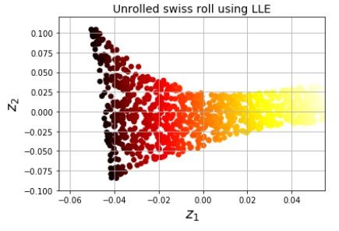
LLE
Local Linear Embedding (LLE) in scikit-learn
LocallyLinearEmbedding class in sklearn.manifold
Run on the swiss roll example
Switch to Notebook

Slide 94
LLE
Observations
Swiss roll is completely unrolled
Distances between the instances are locally preserved
Not preserved on a larger scale
Left most part is squeezed
Right part is stretched
Distance locally preserved

Slide 95
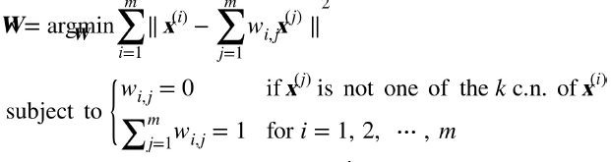
LLE - How it Works? Maths!
How LLE works?
Step 1: For each training instance, the algorithm identifies the k closest neighbours
Step 2: reconstructs the instance as a linear function of these closest neighbours
More specifically, finds the weight w vector such that distance between the closest neighbours and the instance is as small as possible.

Slide 96
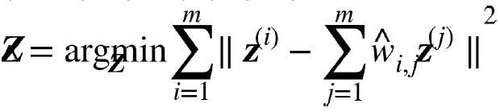
LLE - How it Works? Maths!
How LLE works?
Step 3: Map the training instances into a d-dimensional space while preserving the local relationship as much as possible
Basically, keeping the same weight as calculated in the previous step, the new instance should have minimum distances with the previous closest neighbours (same weights and relationship)

Slide 97
LLE - Time Complexity
How LLE works?
Step 1: finding K nearest neighbors: O(m x log(m) x n x log(k))
Step 2: weight optimization: O(m x n x k^3)
Step 3: constructing low-d representations: O(d x m^2)
Where m = number of training datasets, n = number of original dimensions
k = nearest neighbours d = reduced dimensions
Step 3 makes the model very slow for large number of training datasets

Slide 98
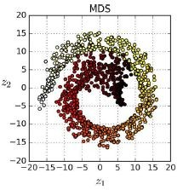
Other dimensionality techniques
Multidimensional Scaling (MDS)
Reduces dimensionality
trying to preserve the instances
>>> from sklearn.manifold import MDS
>>> mds = MDS(n_components=2, random_state=42)
>>> X_reduced_mds = mds.fit_transform(X)

Slide 99
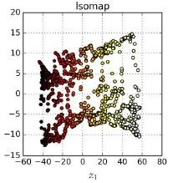
Other dimensionality techniques
Isomap
Creates a graph connecting each instance to its nearest neighbours
Then, reduces dimensionality
Trying to preserve geodesic distances between instances
>>> from sklearn.manifold import Isomap
>>> isomap = Isomap(n_components=2)
>>> X_reduced_isomap = isomap.fit_transform(X)

Slide 100
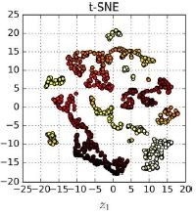
Other dimensionality techniques
T-distributed Stochastic Neighbour Embedding
Reduces dimensionality
Keeping similar instances close and dissimilar apart
Mostly used for visualize clusters in high-dimensional space
>>> from sklearn.manifold import TSNE
>>> tsne = TSNE(n_components=2)
>>> X_reduced_tsne = tsne.fit_transform(X)

Slide 101
Other dimensionality techniques
Linear Discriminant Analysis
A classification algorithm
During training learns the most discriminative axes between the classes
Axes can be used to define the hyper plane to project the data
Projection will keep the classes as far apart as possible
A good technique to reduce dimensionality before running classification algorithms such as SVM Classifier

Slide 102
Other dimensionality techniques
Plotting the results for each of the techniques on the notebook
>>> titles = ["MDS", "Isomap", "t-SNE"]
>>> plt.figure(figsize=(11,4))
for subplot, title, X_reduced in zip((131, 132, 133), titles,
(X_reduced_mds, X_reduced_isomap, X_reduced_tsne)):
plt.subplot(subplot) plt.title(title, fontsize=14)
plt.scatter(X_reduced[:, 0], X_reduced[:, 1], c=t, cmap=plt.cm.hot) plt.xlabel("$z_1$", fontsize=18)
if subplot == 131:
plt.ylabel("$z_2$", fontsize=18, rotation=0) plt.grid(True)
>>> plt.show()
Switch to Notebook

Slide 103
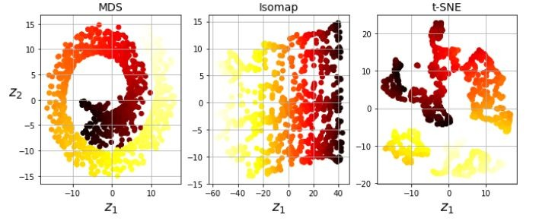
Other dimensionality techniques
Plotting the results for each of the techniques on the notebook

Slide 104

Archives

Slide 105

PCA- Projecting down to d dimensions
Similarly, the
original training dataset X can be projected onto
the first ‘d’ principal components Wd
Composed of first ‘d’ columns of transpose(V) obtained in SVD
Reducing the dataset dimensions to ‘d’
^{X}d-proj ^{= X.W}d
Wd = first d columns of transpose(V) containing the first d principal components

